Slide 1
Using Conversion Functions and
Conditional Expressions

Slide 2
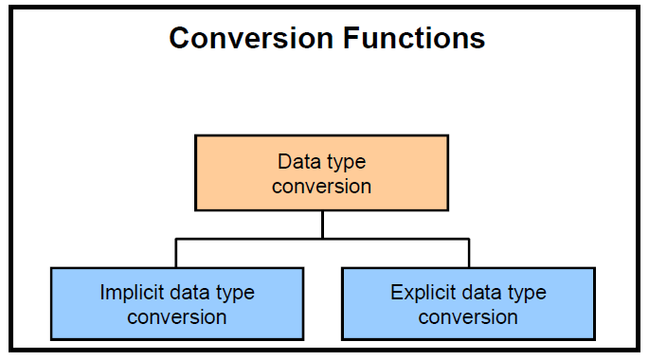
Done by user
Using conversion function
Done by oracle

Slide 3
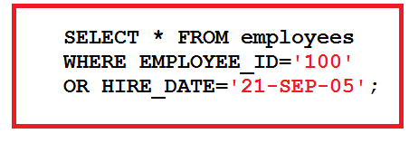
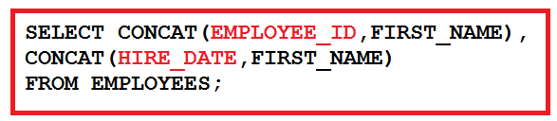
Implicit Data Type Conversion
expressions
expression evaluation
From | To
VARCHAR2 or CHAR VARCHAR2 or CHAR | NUMBER DATE
From | To
NUMBER DATE | VARCHAR2 or CHAR VARCHAR2 or CHAR

Slide 4
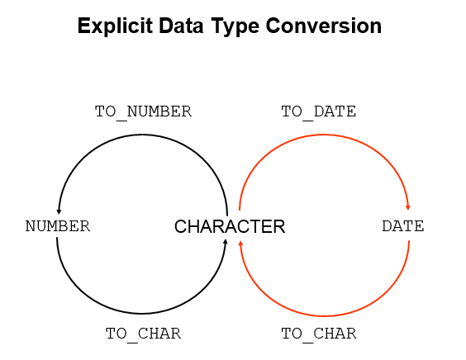

Slide 5
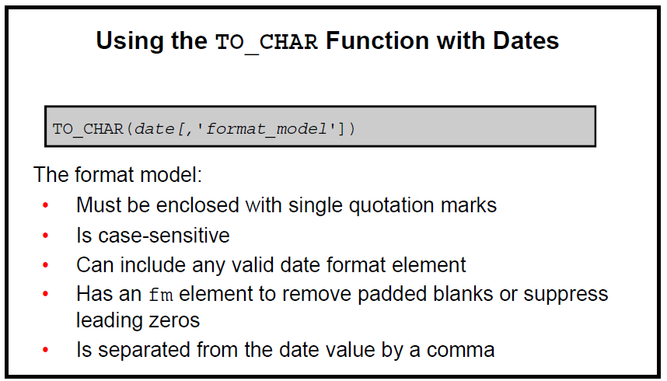

Slide 6
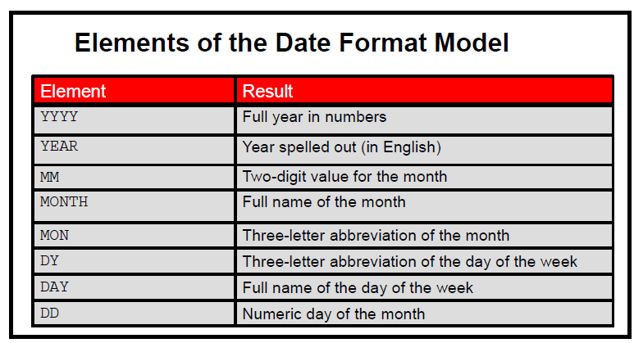

Slide 7
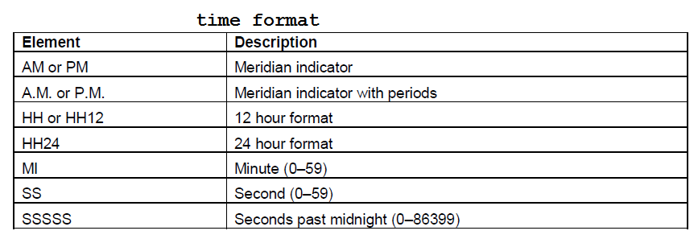

Slide 8
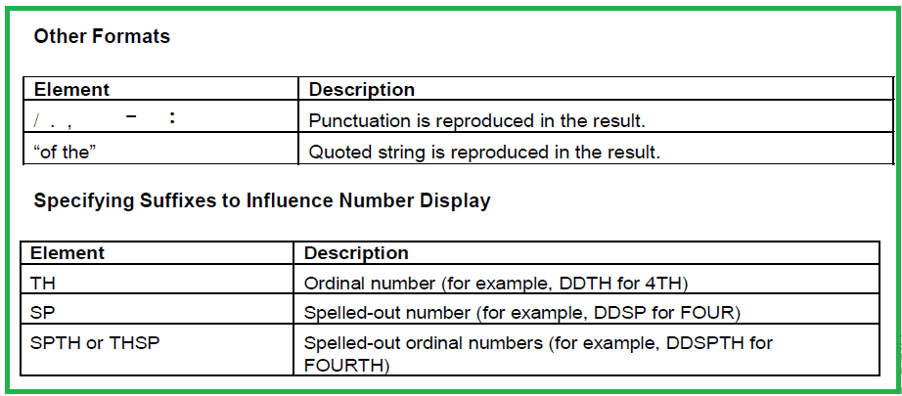

Slide 9
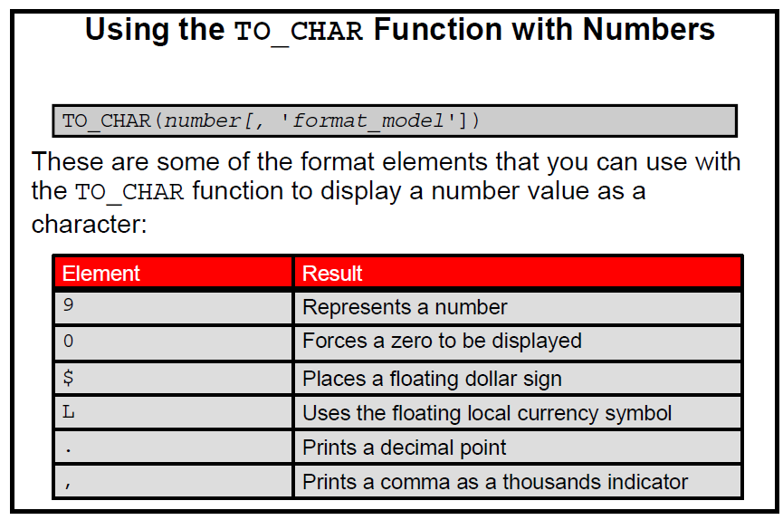

Slide 10
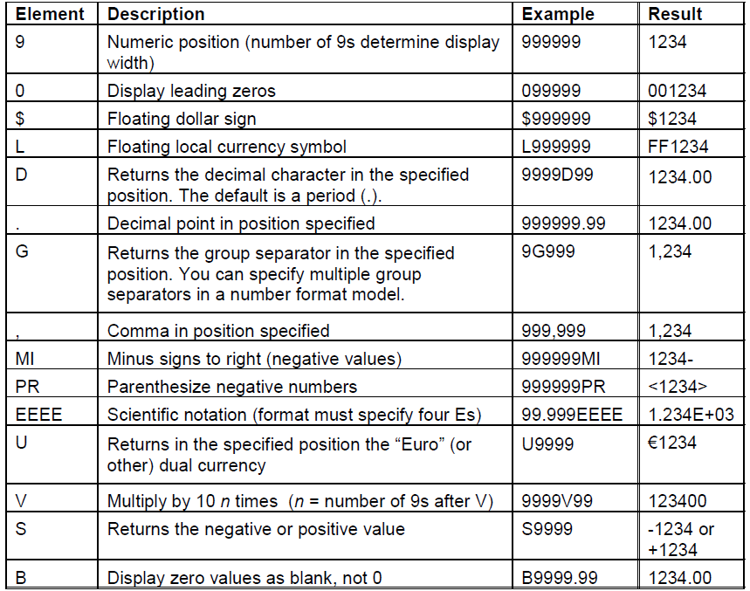

Slide 11
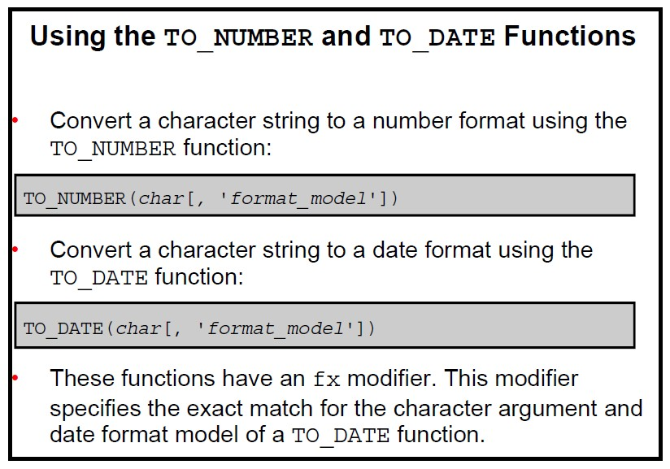

Slide 12
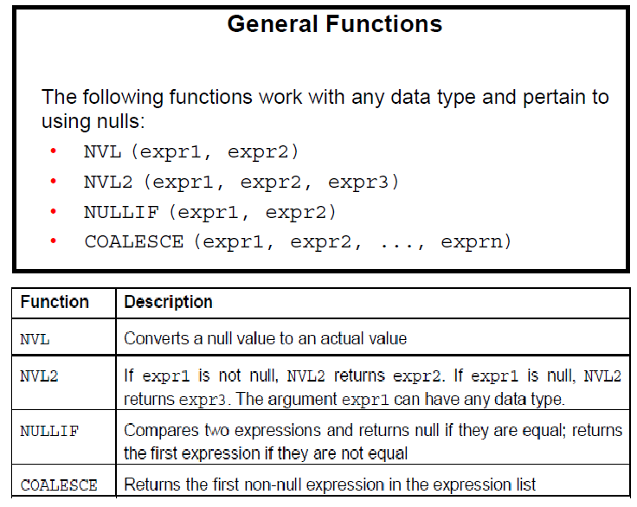

Slide 14
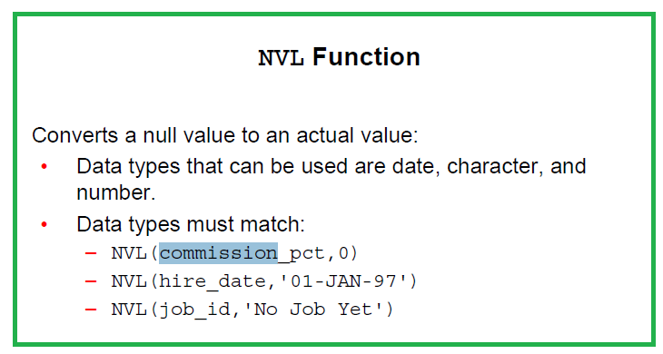

Slide 15
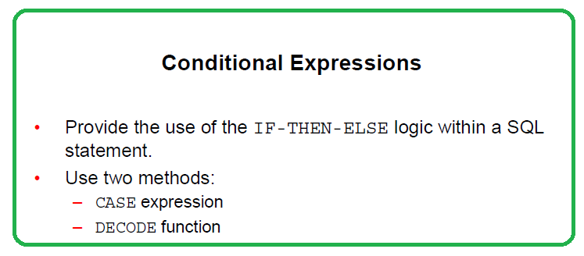

Slide 16
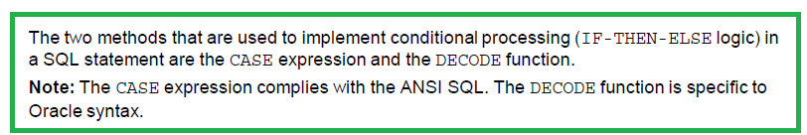

Slide 17
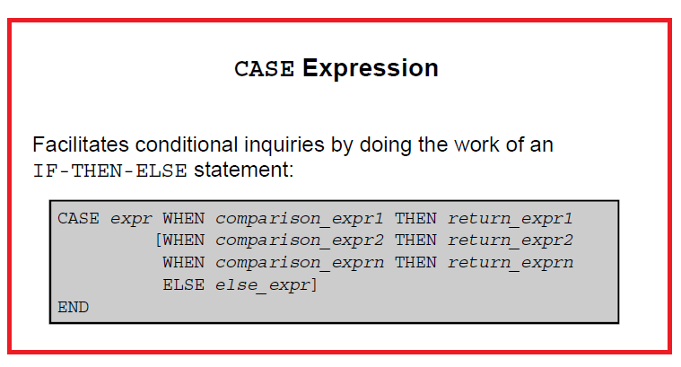

Slide 18
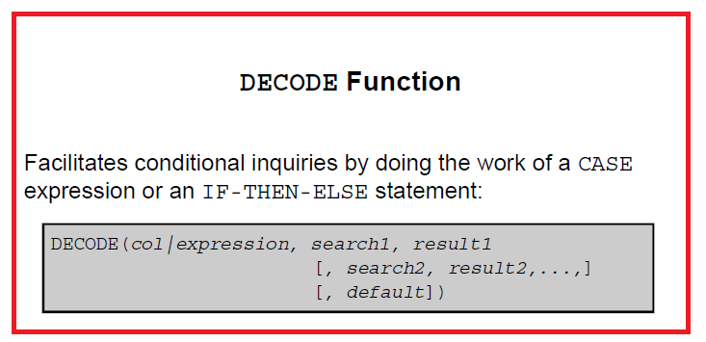

Slide 19
Thank You
Prepared By :Khaled AlKhudari
18

